Slide 1

MOBILE APPLICATION Development (114155)
Dr. Owais Hussain

Slide 2

Agenda
Moving between Components
Navigation in React Native
Stack Navigation
Tab Navigation
Drawer Navigation

Slide 3
Sample 2
Moving between Components
In React Native, moving from one View to another is NOT like navigation in the web apps.
In a web app, when you click on a link, a new HTML Page is loaded on your browser.
In a React app, a single main view is loaded. Other views are loaded and unloaded inside this main view through Routes.
This structure makes an app a Single Page Application (SPA).
To enable navigation, the root component must be Navigation container component.

Slide 4
Sample 2
Navigation in React Native
React Native does not provide Navigation out of the box; 3rd party libraries are used to navigate between views. Alternatively, you may also use react-native-router-flux or react-native-navigation
“React Navigation” is a popular open-source library compatible with Android and iOS.
This library also provides gesture handler to use Swipe based navigation.
There are 3 types of navigations one can perform in React Native:
Stack Navigator: to push and pop views as in a Stack.
Tab Navigator: to provide top or bottom tabs to flip views.
Drawer Navigator: use a drawer/hamburger menu for various views.

Slide 5
Sample 2
Navigation in React Native
Install the following dependencies:
npm install @react-navigation/native
npx expo install react-native-screens react-native-safe-area-context
In the App.js file, make NavigationContainer as your root component:
import { NavigationContainer } from '@react-navigation/native'; export default function App() {
return (
<NavigationContainer>
<View style={styles.header}>
<Text style={styles.headerText}>Baham</Text>
</View>
</NavigationContainer>
);
}

Slide 6
Sample 2
Stack Navigation
Install native Stack navigator
npm install @react-navigation/native-stack
Import the native stack component
Initialize in a constant on top of your App component.
Define the Stack Navigator component inside the Navigation Container.
Attach all the Views as Screens inside the Stack Navigator. Each View will have a unique name to be used as reference.
Specify the initial route name.
You may define some styling to the screen header which shows current screen name.

Slide 7
Sample 2
Stack Navigation – Exercise
import { StyleSheet, View } from 'react-native';
import { NavigationContainer } from '@react-navigation/native'
import { createNativeStackNavigator } from '@react-navigation/native-stack'
import Login from './Login';
import Menu from './Menu’;
const Stack = createNativeStackNavigator();
export default function App() {
return (
<NavigationContainer>
<View style={styles.container}>
<Stack.Navigator initialRouteName='Login' screenOptions={{headerStyle: {backgroundColor: 'lightyellow'}}}>
<Stack.Screen name="Login" component={Login} />
<Stack.Screen name="Menu" component={Menu} />
</Stack.Navigator>
</View>
</NavigationContainer>
);
}
Notes:
Implement this code in your App.js. You can start your exercise from this code: https://github.com/esquaredsystems/baham-mobile/releases/tag/login

Slide 8
Sample 2
Stack Navigation – Exercise
This code should render the Login view. However, we have not told the app when and how to navigate from Login to Menu.
Frist, define a prop: {navigation} in your Login component. This prop is passed from the Stack.Screen component when it renders any component inside.
In the Login component, define a handler function onPress={handleLogin} which will be triggered when the user taps login button.
In the handleLogin function implementation, call the navigation.navigate(‘Menu’) function.
Now, when the user presses Login pressable, the app will tell its parent (i.e., Stack) component to load the Menu component.

Slide 9
Sample 2
Stack Navigation – Exercise
The code sample below will navigate the app from Login to Menu component when handleLogin is called.
You may complete the remaining part of this component like styling, etc.
export default function Login({ navigation }) { const handleLogin = () => {
navigation.navigate('Menu');
} return(
<View style={styles.container}>
<Pressable onPress={handleLogin}>
<Text style={styles.loginButton}>Login</Text>
</Pressable>
</View>
);
}

Slide 10
Sample 2
Stack Navigation
Note that when Stack Navigation is enabled, there is an extra heading on top which shows which View is currently loaded. You can try various styling here to fit your UI.
You can use the phone’s back button to go back to the previous View.
The screens will behave exactly like a Stack. Therefore, you can load a view, then from within that view call another view, and then another view.

Slide 11
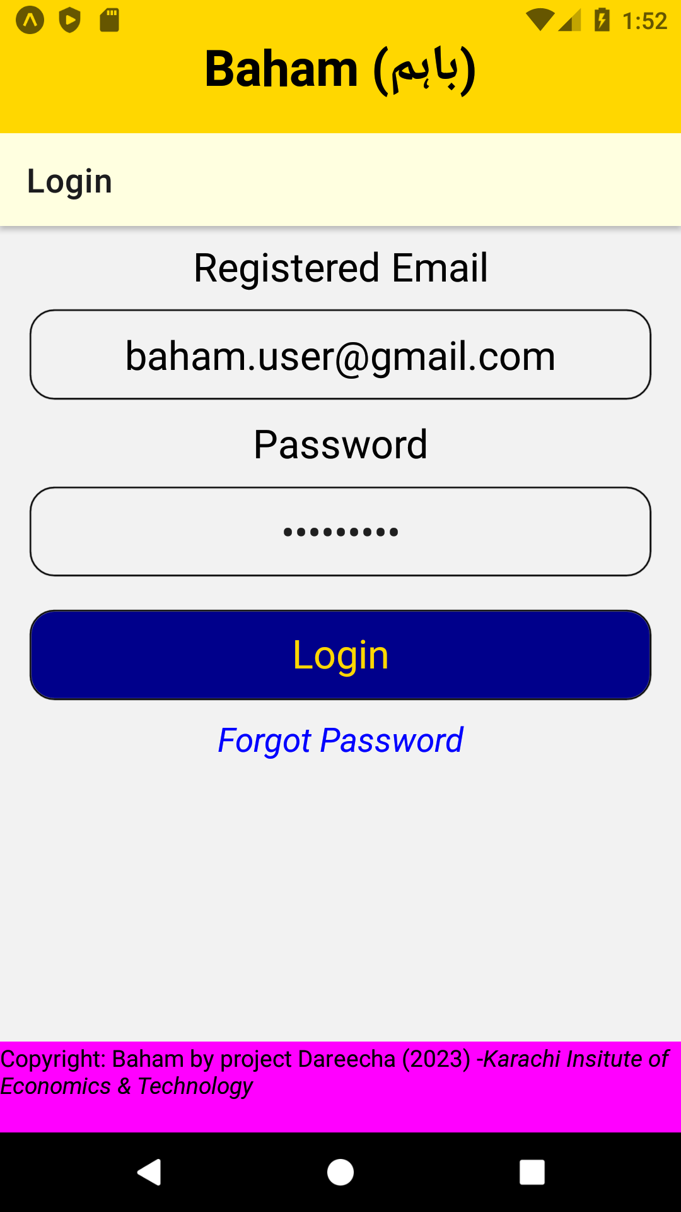
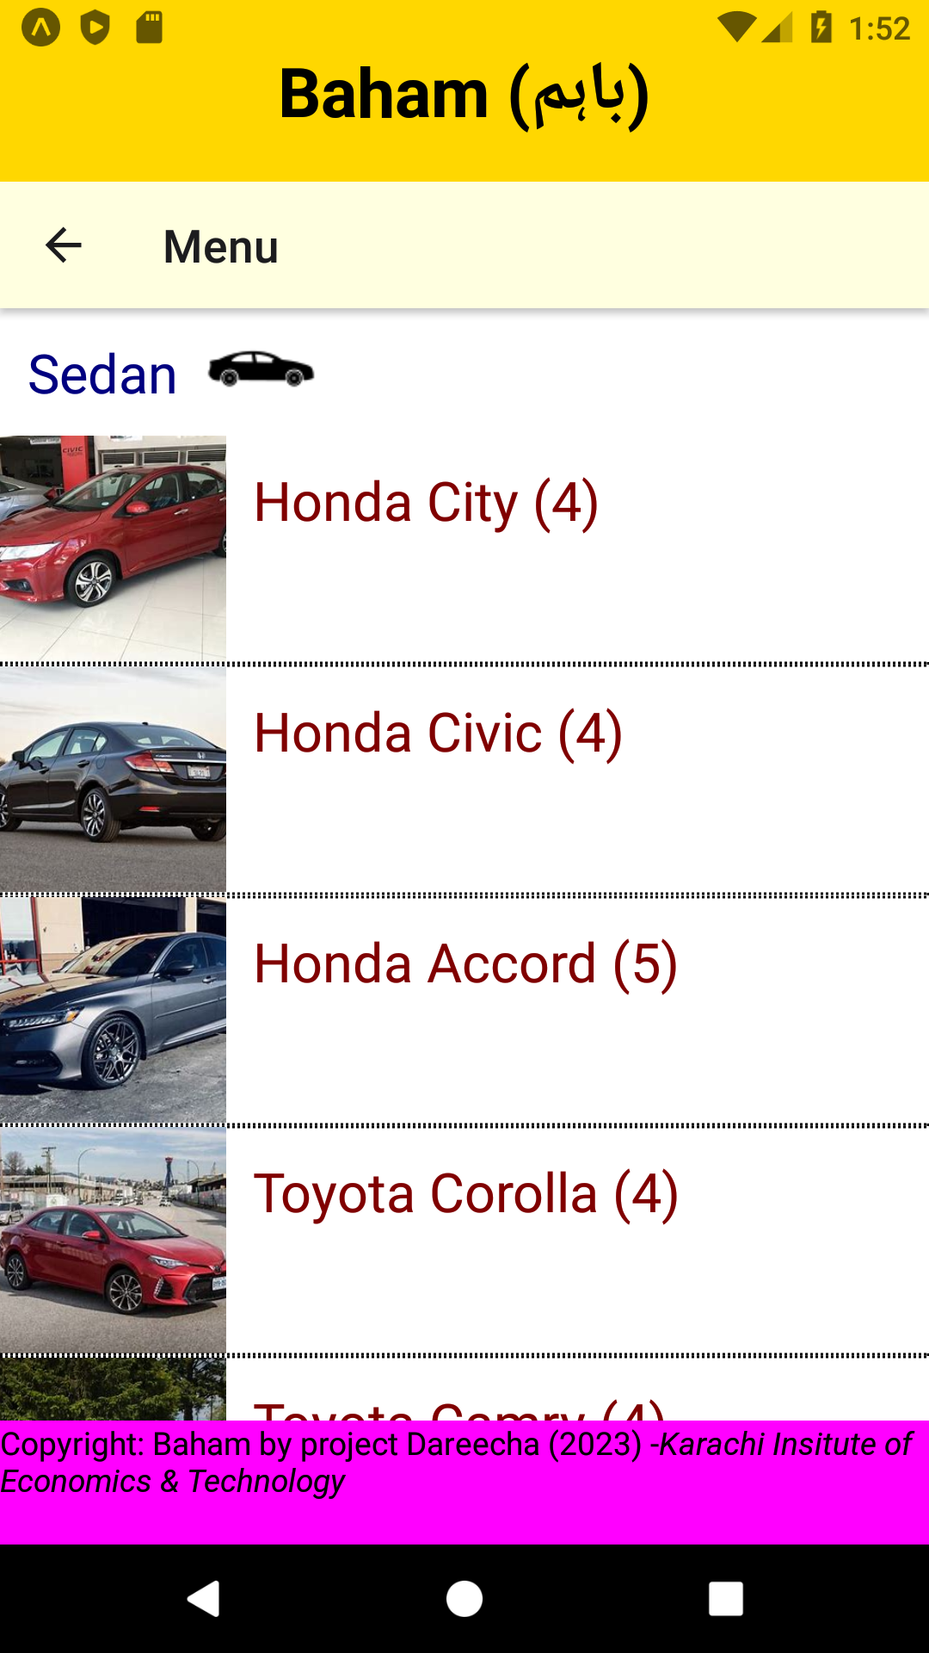
Sample 2
Stack Navigation
On left is the Login view.
On pressing Login button, the app navigates to the Menu view on the right.
On pressing back button, you will be back again to Login view.

Slide 12
Sample 2
Tab Navigation
Install native Tab navigator
npm install @react-navigation/bottom-tabs
Import the bottom tab component
Initialize in a constant on top of your App component.
Define the Tab Navigator component inside the Navigation Container.
Attach all the Views as Screens inside the Tab Navigator. These steps are similar to Stack navigator.
Additionally, you should specify Icons, Active and Inactive tint colours to stylize your tab buttons. Beware! This part is a bit tricky.

Slide 13
Sample 2
Tab Navigation – Exercise
import { StyleSheet, View } from 'react-native';
import { NavigationContainer } from '@react-navigation/native'
import { createBottomTabNavigator } from '@react-navigation/bottom-tabs'
import Login from './Login';
import Menu from './Menu’;
const Tab = createBottomTabNavigator();
export default function App() {
return (
<NavigationContainer>
<View style={styles.container}>
<Tab.Navigator>
<Tab.Screen name="Login" component={Login} />
<Tab.Screen name="Menu" component={Menu} />
</Tab.Navigator>
</View>
</NavigationContainer>
);
}
Notes:
Implement this code in your App.js. You can start your exercise from this code: https://github.com/esquaredsystems/baham-mobile/releases/tag/login

Slide 14
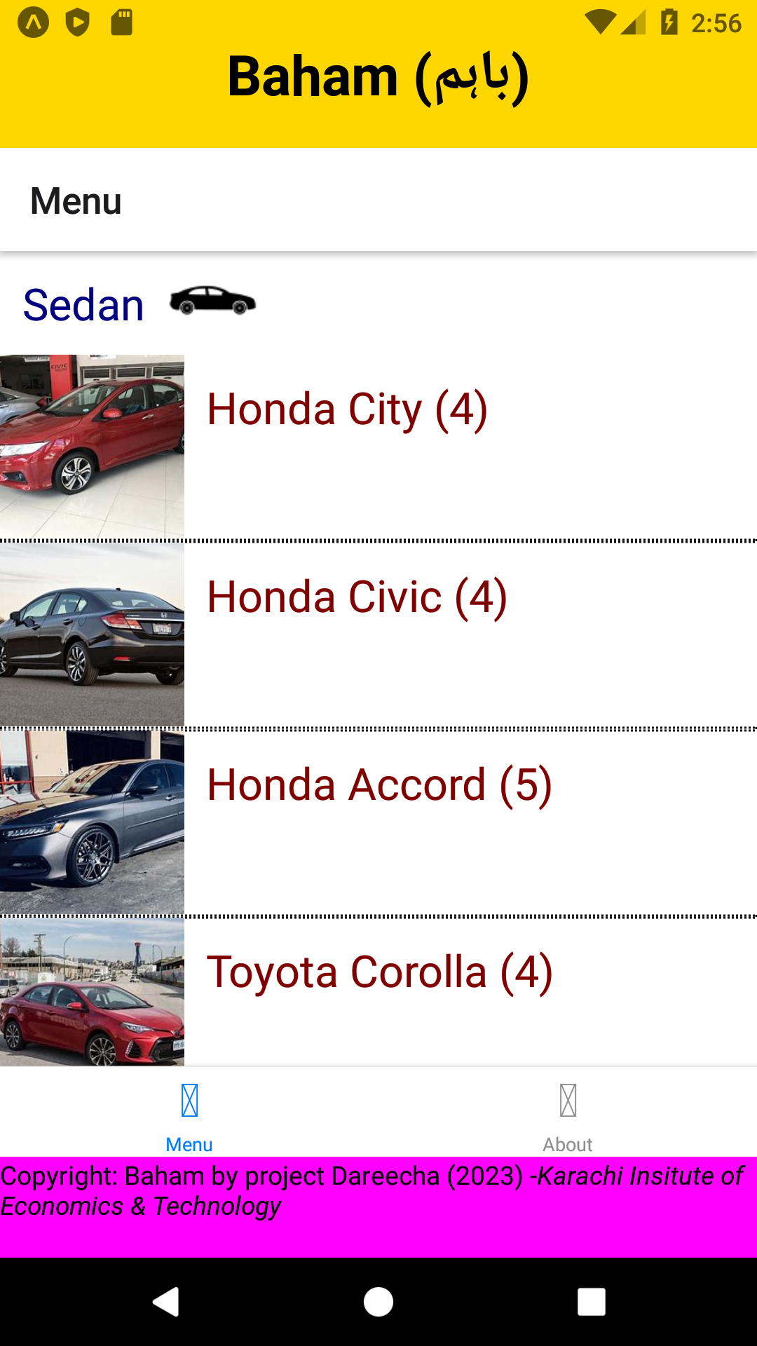
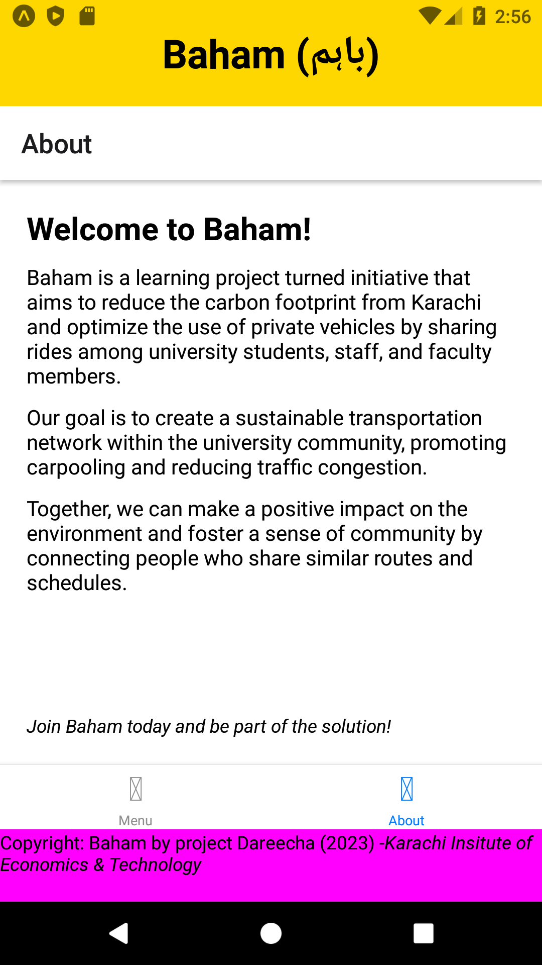
Sample 2
Tab Navigation – Exercise
So far so good. We only replaced Stack with Tab and the navigator changed to Tabs.
Remember! A single Navigation Container can only contain one Navigation, Stack or Tab.
However, the default icons are not a treat to watch.

Slide 15
Sample 2
Tab Navigation – Exercise
You can specify screenOptions to attach icons. Here, we are using MaterialIcon component from @expo/vector-icons library
<Tab.Navigator
screenOptions={({ route }) => ({
tabBarIcon: ({ focused, color, size }) => {
let iconName = 'device-unknown';
if (route.name === 'About') {
iconName = focused ? 'info' : 'info-outline';
} else if (route.name === 'Menu') {
iconName = focused ? 'menu-open' : 'menu';
} else if (route.name === 'Logout') {
iconName = 'logout';
}
return <MaterialIcons name={iconName} size={size} color={color} />;
},
tabBarActiveTintColor: 'navy',
tabBarInactiveTintColor: 'gray',
})}>

Slide 16
Sample 2
Tab Navigation – Exercise
Looking closely at the code, screenOption calls an arrow function with a prop “route”.
Inside the implementation of this arrow function, we are setting tabBarIcon property. However, we want to define a different icon for each route.
The tabBarIcon also calls a nested arrow function with 3 props “focused”, “color”, and “size”
When the target tab is in focus, then we are using a different icon. When it is out of focus, a different icon is shown.
The return statement returns a MaterialIcon component with selected right icon name.
Notes:
Refer to: https://icons.expo.fyi to choose the right icons.

Slide 17
Sample 2
Drawer Navigation
Install Drawer navigator
npm install @react-navigation/drawer
Import the drawer component
Initialize in a constant on top of your App component.
Define the Drawer Navigator component inside the Navigation Container.
Attach all the Views as Screens inside the Drawer Navigator.
One important settings you might need is enabling reanimated plugin in babel.config.js:
presets: ['babel-preset-expo'], plugins: ['react-native-reanimated/plugin'],

Slide 18
Sample 2
Assignment 4
Add Drawer Navigation to the baham-mobile app forked from original repository on Github.
Your final app must contain: Home, Login, Menu, About and Settings views. You will design them according to your own sense of what Baham app should look like.
This is a group project. Each member will submit the same copy of code. If you run into problems doing this assignment, contact other classmates.
No help will be provided from your instructor in this assignment.

Slide 19



THANK YOU
Owais Hussain
+92 345-3174270
owais.hussain@kiet.edu.pk
https://www.researchgate.net/profile/Owais-Hussain-3

